Slide 1
Zoonotic Diseases
Assist. Prof. Dr. Hussein ALNaji

Slide 2
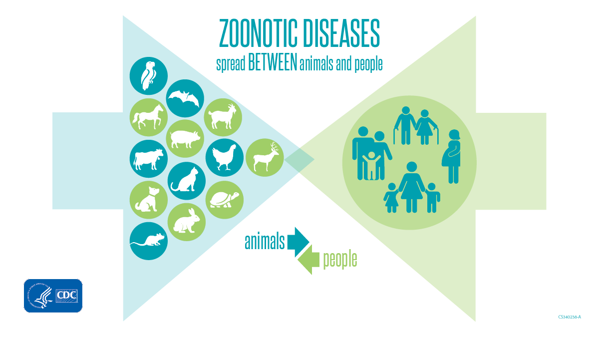
Zoonotic diseases (also known as zoonoses) are caused by germs that spread between animals and people. Animals provide many benefits to people. Animals provide food, fiber, livelihoods, travel, sport, companionship, and education for people across the globe. We might come into contact with animals in either urban or rural settings, during travel, while visiting animal exhibits, or while enjoying outdoor activities.

Slide 3
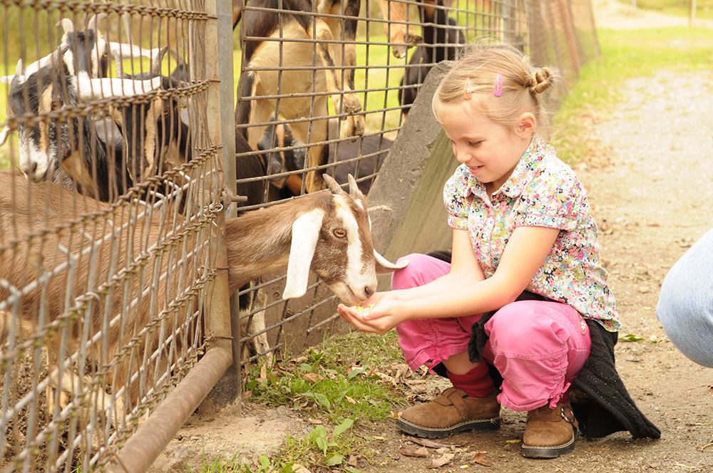
The term “Zoonoses” is derived from the Greek word “Zoon”, which means animal, and “nosos”, which means illness. According to the World Health Organization (WHO), any disease or infection that is naturally transmissible from vertebrate animals to humans or from humans to animals is classified as a zoonosis.
Zoonoses is a great public health concern and a direct human health hazard that may even lead to death.

Slide 4
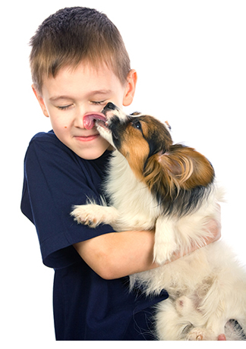
Classification of Zoonoses
Zoonotic diseases are Based on etiology, zoonoses are classified into
1- Bacterial zoonoses (anthrax, salmonellosis, TB, Lyme disease, brucellosis, and plague).
2- Viral zoonoses (such as rabies, acquired immune deficiency syndrome- AIDS, Ebola, and avian influenza).
3- Parasitic zoonoses (trichinosis, toxoplasmosis, giardiasis, malaria, and echinococcosis).
4- Fungal zoonoses (such as ring worm).

Slide 5
5- Rickettsial zoonoses (Q-fever).
6-chlamydial zoonoses (psittacosis).
7-Mycoplasma zoonoses (Mycoplasma pneumoniae infection).
8- Protozoal zoonoses.
9- Diseases caused by acellular non-viral pathogenic agents (such as transmissible spongiform encephalopathies and mad cow disease).
Based on etiology, bacteria account for most zoonotic diseases. It has been estimated that among the zoonotic pathogens originating from bovine origins, about 42% are of bacterial origin, 22% viral, 29% parasitic, 5% fungal, and 2% prion origin . Similarly, both DNA and RNA viruses are known to be responsible for zoonoses; however, compared to DNA, the RNA viruses are more frequently linked with zoonoses

Slide 6
The older classification of zoonoses includes the terms Anthropozoonoses, zooanthroponoses, amphixenoses, and euzoonoses.
1- Anthropozoonoses are animal diseases that can be transmitted to humans, such as rabies.
2- Zooanthroponoses refers to those diseases that are transmitted to animals from humans such as tuberculosis in cat and monkey.
3- Amphizoonoses are those diseases that can be transmitted in any direction (from human to animal and from animal to human) such as staphylococcal infection.
4- For some parasitic diseases, humans act as the obligatory host. These parasitic diseases are known as Euzoonoses such as Taenia solium and Taenia saginata infections.

Slide 7
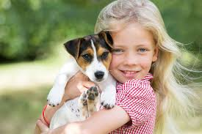
Because of the close connection between people and animals, it’s important to be aware of the common ways people can get infected with germs that can cause zoonotic diseases. These can include:
1- Direct contact: Coming into contact with the saliva, blood, urine, mucous, feces, or other body fluids of an infected animal. Examples include petting or touching animals, and bites or scratches.
2- Indirect contact: Coming into contact with areas where animals live and roam, or objects or surfaces that have been contaminated with germs. Examples include aquarium tank water, pet habitats, chicken coops, barns, plants, and soil, as well as pet food and water dishes.

Slide 8
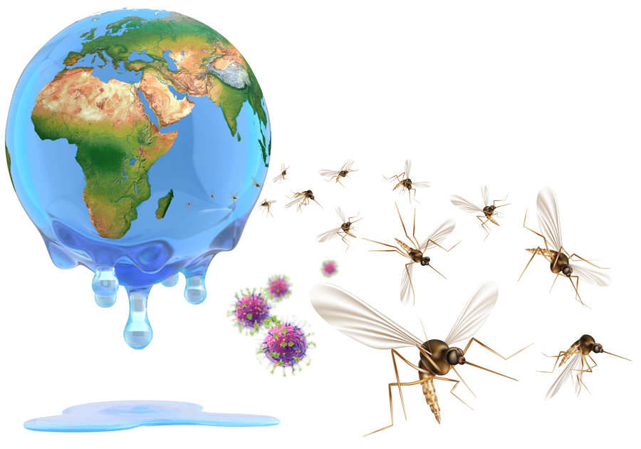
3- Vector-borne: Being bitten by a tick, or an insect like a mosquito or a flea.
4- Foodborne: Eating or drinking something unsafe, such as unpasteurized (raw) milk, undercooked meat or eggs, or raw fruits and vegetables that are contaminated with feces from an infected animal. Contaminated food can cause illness in people and animals, including pets.
5- Waterborne: Drinking or coming in contact with water that has been contaminated with feces from an infected animal.

Slide 9
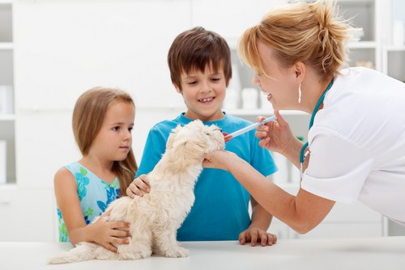
Who is at a higher risk of serious illness from zoonotic diseases?
Anyone can get sick from a zoonotic disease, including healthy people. However, some people are more at risk than others and should take steps to protect themselves or family members.
1- Children younger than 5
2- Adults older than 65
3- People with weakened immune systems
4- Pregnant women

Slide 10
Control
The following four surveillance types can be practiced for the control of zoonoses:
1- Pathogen surveillance to detect and identify pathogens.
2- Serological surveillance to detect the presence of pathogens in the blood of humans or animals through monitoring immune responses.
3- Syndrome surveillance to determine the propensity of diseases through data analysis based on symptoms. This analysis-based surveillance cannot be used identify the presence of pathogens.
4- Risk surveillance to detect risk factors responsible for the transmission of disease.
General principals of disease control such as providing treatment to affected individuals, vaccination of healthy individuals and animals, restricting animal movement, animal population control, and test and cull (anthrax, glanders, and Rift Valley fever) can also be used for the control of zoonoses.

Slide 11
Thank you

